Slide 1


De novo assembler principles

Slide 2
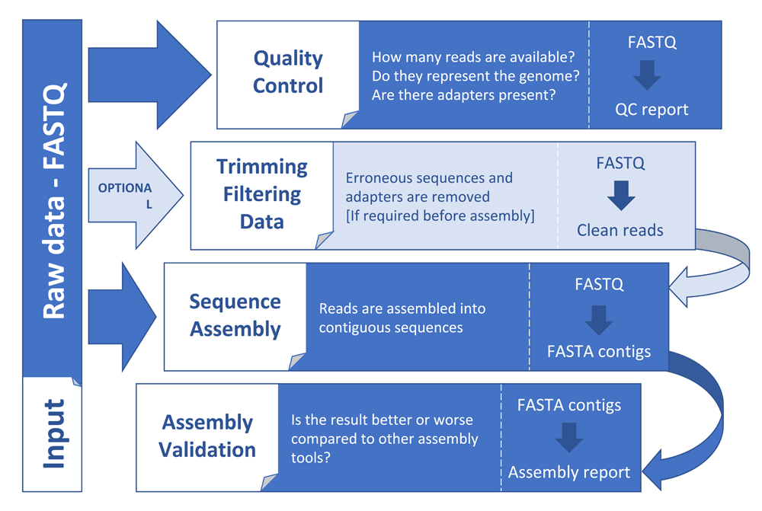
General principles in assembly
Dominguez Del Angel. et al. 2018

Slide 3
General principles in assembly
Sequence assembly
Reference guided
De novo

Slide 4
General principles in assembly
Sequence assembly
Reference guided
De novo

Slide 5
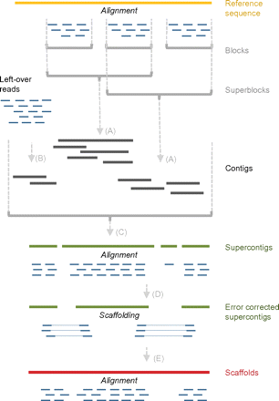
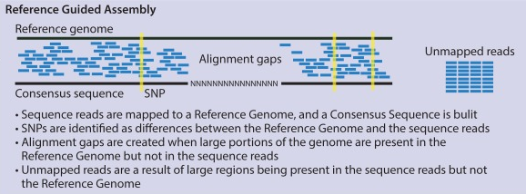
Reference guided assembly
Simple organisms
Align
Call variants
Make consensus
Complex organisms
Align and call blocks
De novo assemble left-overs
Assemble contigs
Ronholm et al. 2016
Schneeberger et al. 2011

Slide 6
De novo assembly
Overlap
Correction (optional)
Simplification
Consensus
Path finding

Slide 7
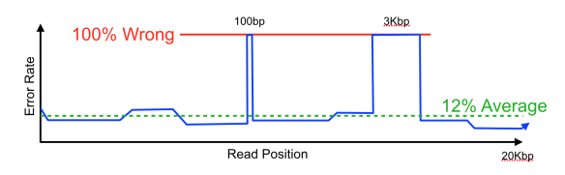
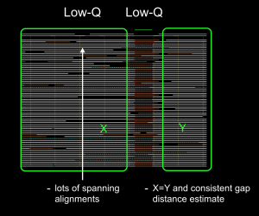
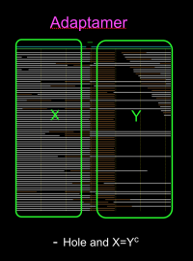
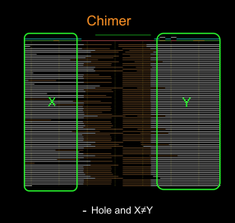
De novo assembly
De novo assemblers - correction (optional)

Slide 8
De novo assembly
De novo assemblers - overlap
K-mers
Seeds
e.g. de Bruijn graph
e.g. mhap

Slide 9
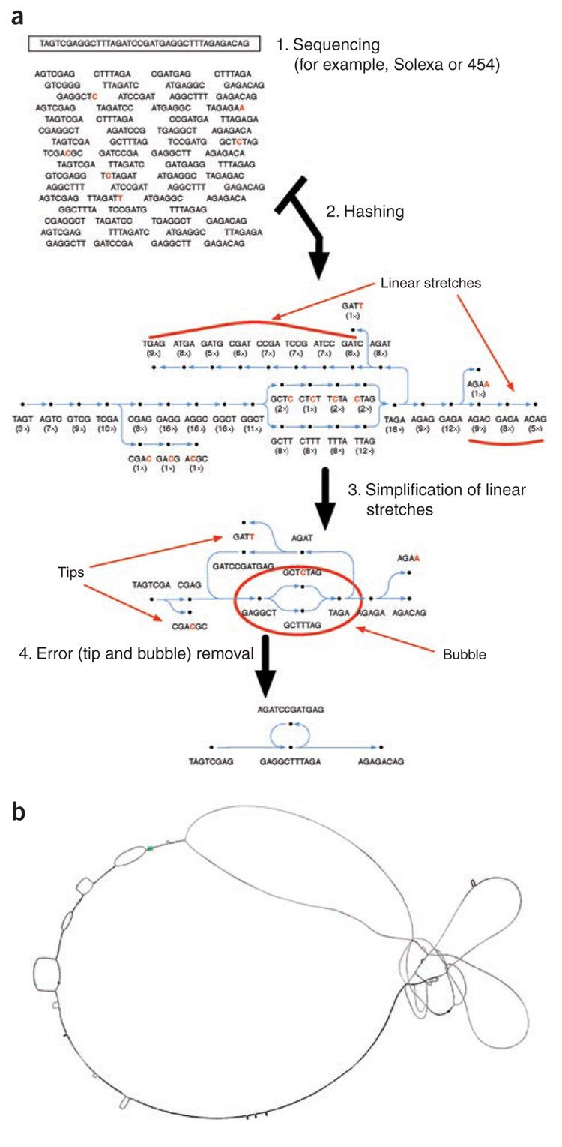
De novo assembly
De novo assemblers - simplification
Flicek & Birney. 2009.

Slide 10
De novo assembly
De novo assemblers - simplification
Flicek & Birney. 2009.

Slide 11
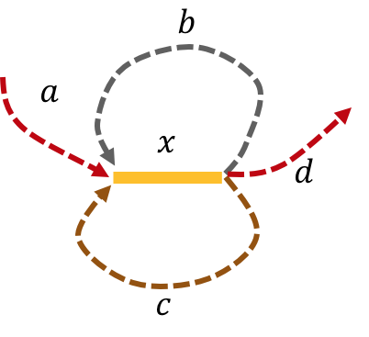
De novo assembly
De novo assemblers - path finding
a - x - b - x - c - x - d
a - x - c - x - d - x - d

Slide 12
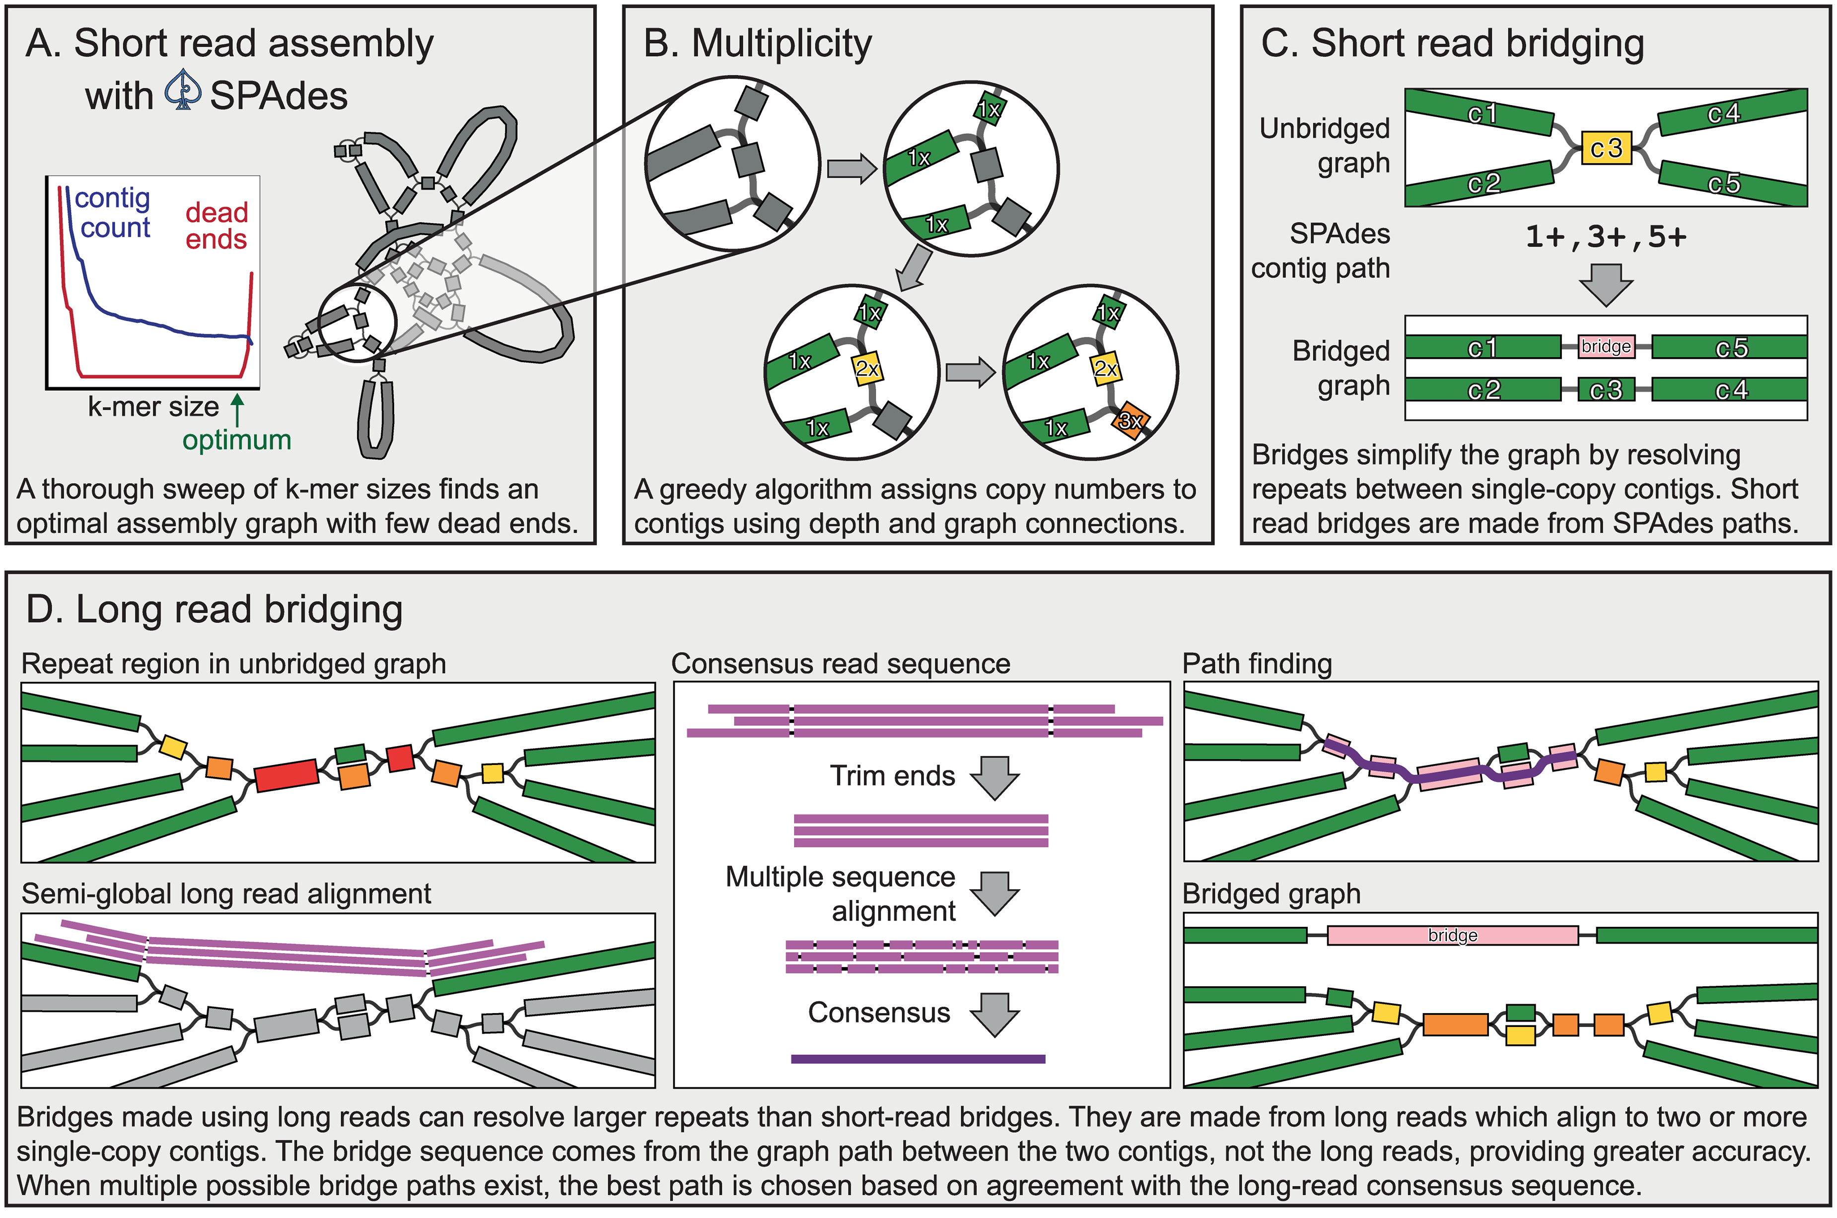
De novo assembly
Wick et al. 2017
De novo assemblers - path finding

Slide 13
De novo assembly
De novo assemblers - consensus
TGACTTAT
GTTACTTAT
TGATTGACGTGA
TGACTTATGTTACTTATTGATTGACGTGA
TGATTGACGTGA
TGACTTAT
GTTACTTAT
TGATTGACGTGA
TGACTTATGTTACTTAT
TGATTGACGTGA
TGATTGACGTGA

Slide 14
De novo assembly
Additional steps
Scaffolds
Contigs
Gap filling
Polishing
Corrections

Slide 15
De novo assembly
Scaffolding
10X Genomics
NNNNN
Mate Pair
Hi - C

Slide 16
De novo assembly
Gap filling
PacBio
ONT
10X Genomics
NNNNNNNNNNN
Assemblies:
Assembly reconciliation

Slide 17
De novo assembly
Corrections: e.g. bacterial assembly
Circular assemblies have an overlap at the end
Find conventional start site
e.g. between the genes `rpmH` and `dnaA`.
Merge the assembly again at the overlap.

Slide 18
De novo assembly
Polishing
Multiple rounds of polishing:
Long read x2
Short read x1

Slide 19
De novo assembly - summary
Correction
Scaffolding
Overlap
Gap filling
Simplification
Correction
Path finding
Polishing
Consensus

